Slide 1
Designing to Support Blind and Visually Impaired Older Adults in Managing the Invisible Labor of Social Participation: Opportunities and Challenges
Presented by
Protik dey

Slide 2
overview
Why This Paper?
Terminology
Motivation
Methodological Approach
Findings
Discussion
Limitations and Future Works
Key Takeaways
Conclusion

Slide 3
Why this paper?
Research Interest
Current Project
Excellent Thematic Analysis

Slide 4

terminology
Older Adults: People who are 60 years or older
Invisible Labor: Extra, often hidden efforts that blind and visually impaired (BVI) older adults must invest to participate in social activities

Slide 5
Motivation
Social Participation
Accessibility Challenges
Role of Technology

Slide 6
Research questions
What are the current experiences of older adults with visual disabilities when attempting to connect with friends, family, or others in their community?
What barriers do older adults with visual disabilities face while connecting/interacting with others within their community?
What is the role of technology, including voice assistants, in helping to manage social activities within the community?

Slide 7
Methodological Approach
Design: Qualitative study using semi-structured interviews
Participant: 16 blind or visually impaired adults aged 60+, residing individually
Recruitment: Through online list and forums for blind and visually impaired adults
Interview: One-on-one interviews remotely using phone calls or video conference
Duration: 50-60 minutes

Slide 8
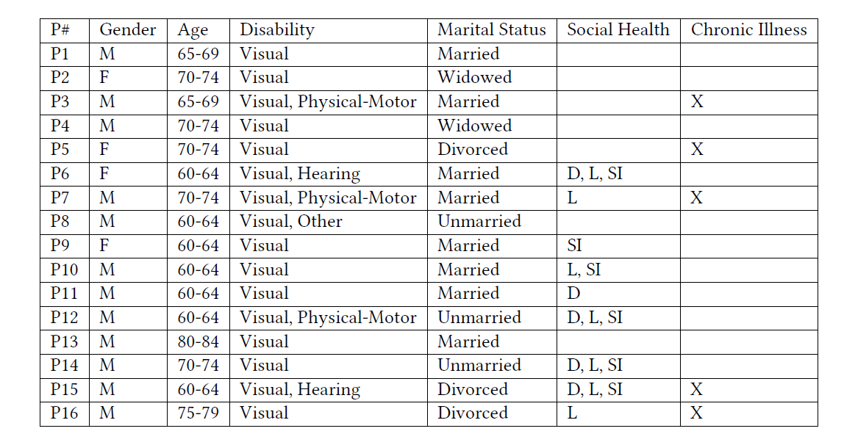
Participant demographics
D – Depression or other mood related
L –Loneliness
SI – Social Isolation

Slide 9
findings
Theme 1 : Experiences Connecting with Others in Later Life
Theme 2: Managing Invisible Labor and Social Participation in Sighted Environments
Theme 3: Using Technology to Connect Socially

Slide 10
Theme 1 : Experiences Connecting with Others in Later Life
Navigating Social Participation in Later Life
Adapting to changing social networks due to retirement, pandemic and changing caregiver responsibility
Difficulty finding common topics and fear of initiating a conversation due to societal division

Slide 11
Theme 1 : Experiences Connecting with Others in Later Life
Current Involvement in Community Social Activities
56% participants were involved in group activities at senior centers, sports clubs etc.
31% participants were engaged in physical activities
Participants knew and felt the importance of social activities

Slide 12
Theme 2 : managing invisible labor and social participation in sighted environments
Building New Social Networks as an Older Adult with a Visual Disability
Challenges connecting with sighted people because of lack of experience
Difficulties finding social groups for blind and visually impaired older adults due to limited opportunities and channels

Slide 13
Theme 2 : managing invisible labor and social participation in sighted environments
Managing Logistical Challenges and Accessibility Needs
Struggles of finding accessible transportation
Learning facility layout before attending caused additional difficulty

Slide 14
Theme 2 : managing invisible labor and social participation in sighted environments
Managing Other’s Perceptions and Lack of Awareness of Access Needs
People in society are not aware how to accommodate people with disabilities who wishes to join group social activities
Additional labor to connect with sighted individuals socially due to lack of awareness

Slide 15
Theme 3 : using technology to connect socially
Current Use of Technology to Support Social Participation
Various communication channels including phone, email, social media to connect socially
Heavily relying on word of mouth and referrals to find social events

Slide 16
Theme 3 : using technology to connect socially
Use of Voice Technologies to Connect Socially
Most participants use different voice technologies for entertainment and daily activity
Participants had mixed about voice technologies for social activities, but felt that there are opportunities to use them for social engagement in the future

Slide 17
discussion
Designing for Interrelated Access and Social Needs
1
Designing to Support Inclusive Social Events through Education and Training
2
Designing to Support Mixed-Ability Social Engangements
3

Slide 18

limitations
Participants Demographics: Limited to younger-older adults (60-64 years)
Recruitment Methods: Recruitment was done digitally excluding population with less digital literacy

Slide 19
Future works
Broader Participant Inclusion
Technology Design and Testing
Reducing Invisible Labor

Slide 20
Key takeaways
Blind and visually impaired older adults face layered challenges when engaging socially, impacting their mental and emotional health
To reduce invisible labor, inclusive tech should integrate social and accessibility needs, offering a single platform for social event info, transportation, and venue layout.

Slide 21
conclusion
The paper provides a foundation for understanding how technology can be designed to support blind and visually impaired older adults, with a focus on reducing invisible labor.
This paper also provides future directions regarding designing integrated, accessible platforms that provide all necessary social engagement information.
The work also aims to reduce hidden burdens in accessibility, fostering more inclusive communities for blind and visually impaired older adults.

Slide 22

Any questions?

